Slide 1
Substation and Distribution Automation
Module 10: Introduction to Micro-Grids

Slide 2
Module 10 Overview
Part 1: …
Part 2: …
Part 3: …
Part 4: …

Slide 3
Recommended reading
N. Hatziargyriou et al, “Microgrids” IEEE Power & Energy Magazine, July/August 2007
J. Driesen et al, “Design for distributed energy resources,” IEEE Power & Energy Magazine, May/June 2008
B. Kroposki et al, “Making microgrids work,” IEEE Power & Energy Magazine, May/June 2008
F. Katiraei et al, “Microgrids management,” IEEE Power & Energy Magazine, May/June 2008
C. Marnay et al “Future Roles of Milli-, Micro-, and Nano- Grids,” CIGRÉ International Symposium, Bologna, Italy, September, 2011

Slide 4
Distributed energy resources (DER)
Microgrids are a framework to address the integration and control of distributed energy resources (DER)
DERs include:
Small (kW-scale) combined heat and power (CHP)
Distributed renewable generation: e.g. rooftop photovoltaic panes, small wind turbines, biogas digesters
Heat and electricity storage
Controllable loads (demand response): e.g. electric water heaters, HVAC, other controllable appliances

Slide 5
What are microgrids?
Definition of microgrid¹: Group of locally-controlled distributed energy resources (DER) connected to a low voltage (≈≤ 1 kV) or medium voltage (≈ 1 to 69 kV) distribution network.
Behaves as a single producer or load
Can operate in islanded mode
Small isolated power system also seen as microgrids
Microgrids that can separate from utility grid during disruption and continue to serve critical local load until grid service is restored (main objective of CERTS microgrid)
¹: N. Hatziargyriou et al, “Microgrids” IEEE Power & Energy Magazine, July/August 2007

Slide 6
Why microgrids?
Microgrids is a way to enable benefits of DERs:
Increase energy efficiency through combined heat and power (CHP)
Reduce carbon emissions
Increase local power quality and reliability
Reduced line losses
Transmission investment deferral
Reduce expensive fuel consumption in remote isolated microgrids
Challenge of controlling large number of DER can be addressed by microgrids. Microgrids coordinate DERs in a decentralized way reducing the control burden on the grid.
Enable provision of heterogeneous levels of power quality and reliability (PQR). For example, very high PQR provided to essential services like hospitals and communication equipment, while lower PQR provided to non essential loads like water pumps.

Slide 7
Consortium for Electricity Reliability Solutions (CERTS) Microgrids
Emphasis on microgrids that can separate from utility grid during disruption and continue to serve critical local load until grid service is restored
< 2MW peak sites,
No need of costly fast electrical controls
Droop controllers responding to local voltage and frequency
Single point of common coupling that does not export power (single controlled load)
No single device is essential (robust system)
Design to provide heterogeneous power quality and reliability. Sensitive loads served in island mode during disruption
Generic slow controls, e.g. economic dispatch

Slide 8
Future role of milligrids, microgrids, and nanogrids
Radical reorganization of parts of the distribution network and customer sites
New proposed entities: community grids or milligrids that operate a segment of the existing distribution system, microgrids which are akin to current customer sites but which have automonous control, and nanogrids, such as telecom or Ethernet networks that currently distribute power to many low-power devices (typically DC with high power quality and reliability).
Local heterogeneous power quality and reliability (PQR) becomes a possibility
C. Marnay et al “Future Roles of Milli-, Micro-, and Nano- Grids,” CIGRÉ International Symposium, Bologna, Italy, September, 2011

Slide 9
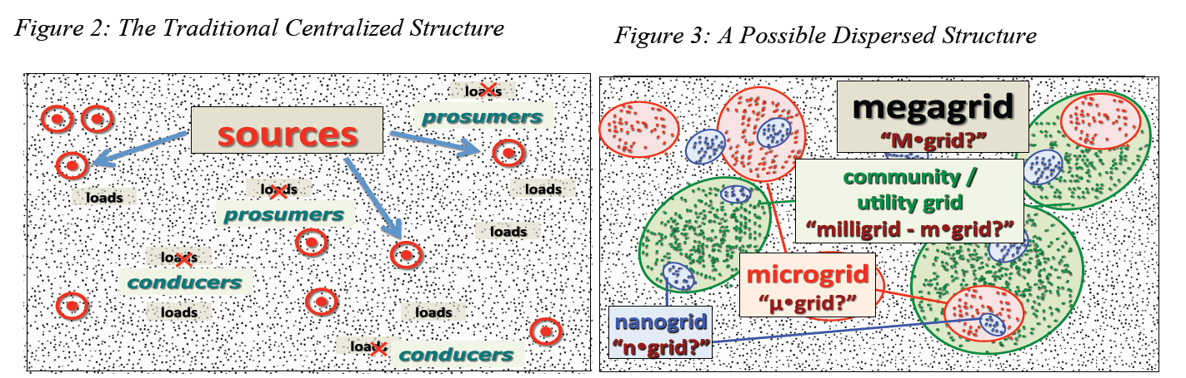
Milligrids, microgrids, and nanogrids
Few large generators
With distributed generation, some small consumers could become producers at some moments (prosumers)
Highly centralized control (traditional paradigm)
Microgrids (or customer microgrid): Independent control nodes. One meter, and one or few points of interconnections
Milligrids (utility microgrid): Sections of distribution network including generation and loads. Public utility regulation
Nanogrids: Low energy grids, typically DC, designed to deliver high PQR
C. Marnay et al “Future Roles of Milli-, Micro-, and Nano- Grids,” CIGRÉ International Symposium, Bologna, Italy, September, 2011

Slide 10
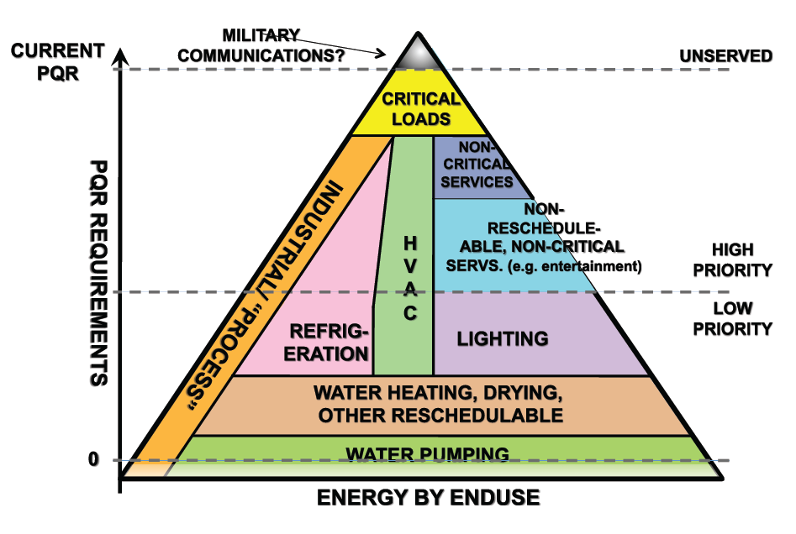
Enabling heterogeneous power quality and reliability
C. Marnay et al “Future Roles of Milli-, Micro-, and Nano- Grids,” CIGRÉ International Symposium, Bologna, Italy, September, 2011

Slide 11
Classification of microgrids
Utility Microgrids: Urban and rural
Objectives: Outage management and renewable integration
Transition to grid independent or isolated operation: faults, maintenance
Industrial/commercial microgrids: multi- and single-facility
Objectives: Power quality, reliability and efficiency
Transition to grid independent or isolated operation: faults, power quality, energy price, maintenance
Remote microgrids
Objectives: Electrification of remote areas, reduce fuel consumption through renewable integration

Slide 12
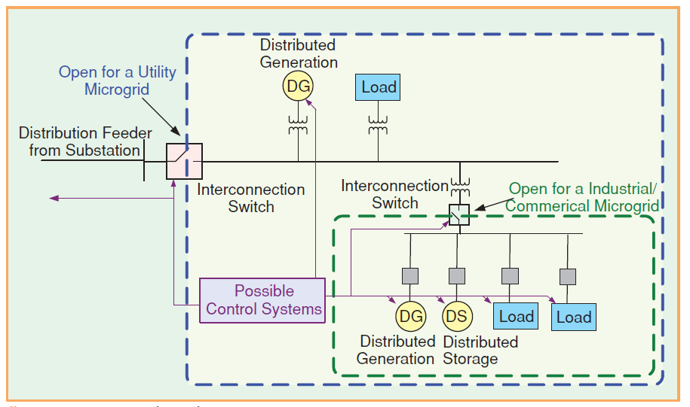
Microgrid components
B. Kroposki et al, “Making microgrids work,” IEEE Power & Energy Magazine, May/June 2008

Slide 13
Distributed generation
Combined heat and power systems
Photovoltaic generators
Wind turbines
Microturbines
Fuel cells

Slide 14
Distributed Storage
Community storage (e.g. batteries, flywheels)
Thermal storage

Slide 15
Demand response
Sensitivity to electricity price
Grid support for stressed condition

Slide 16
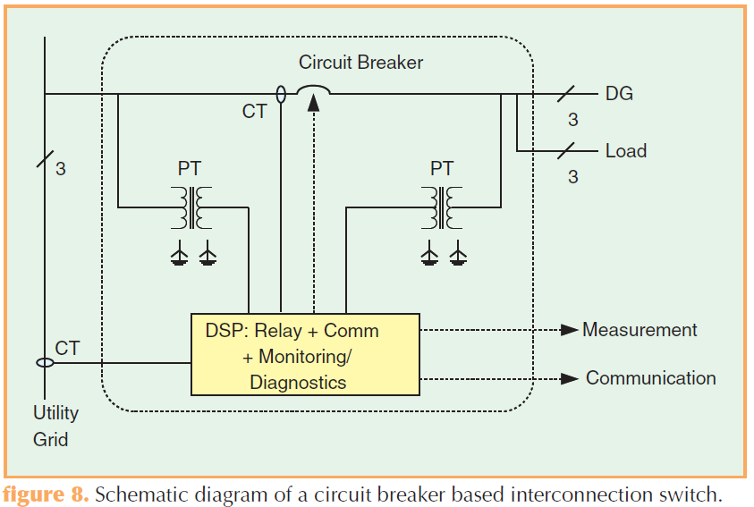
Interconnection switch
Consolidated power switching protective relay metering and communications
Either circuit breaker or semiconductor-based static switches
B. Kroposki et al, “Making microgrids work,” IEEE Power & Energy Magazine, May/June 2008

Slide 17
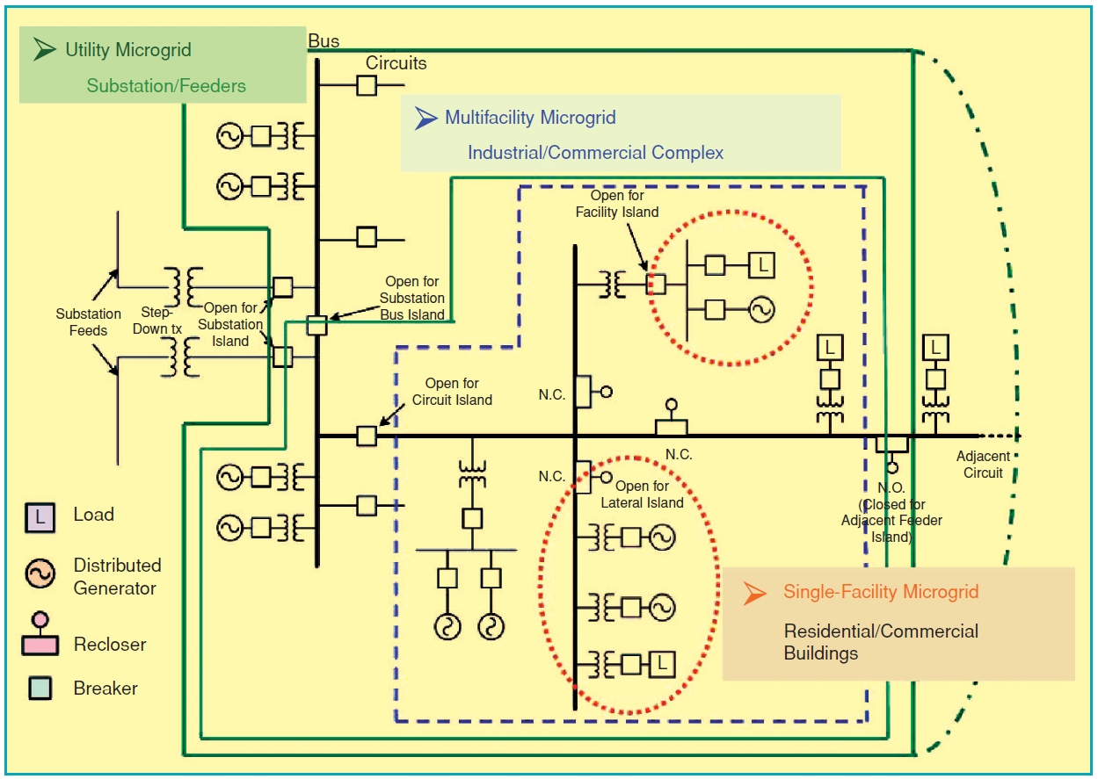
Typical topologies
J. Driesen et al, “Design for distributed energy resources,” IEEE Power & Energy Magazine, May/June 2008

Slide 18
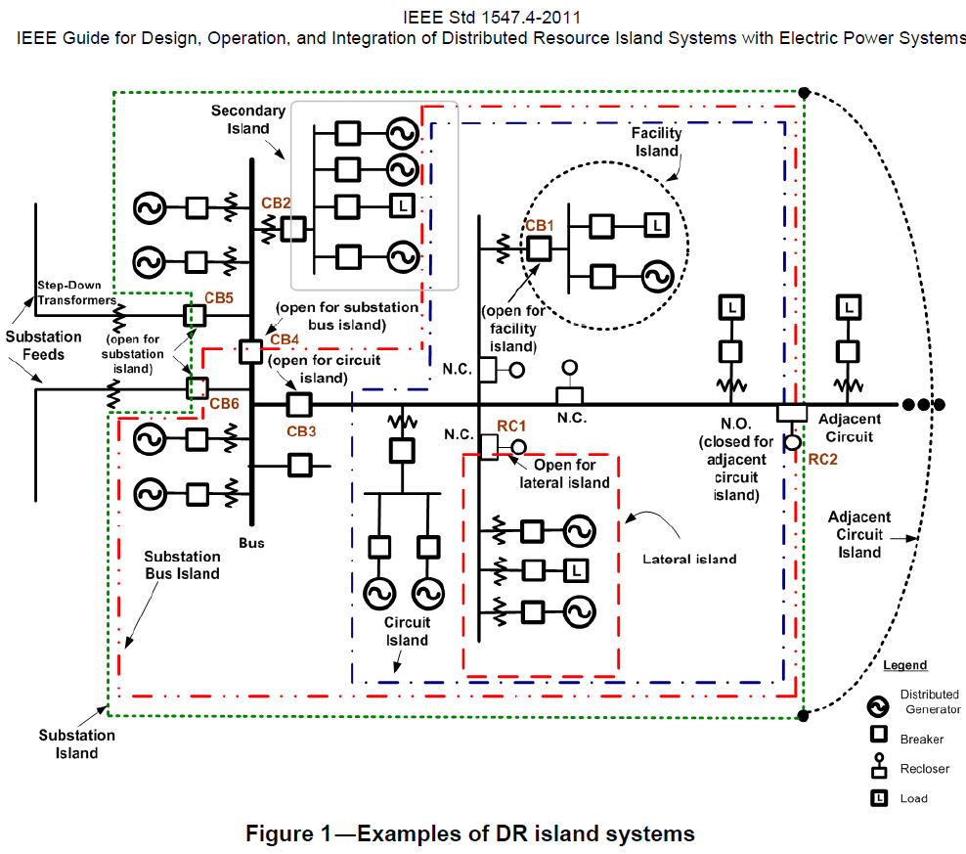
Microgrids typical topologies

Slide 19
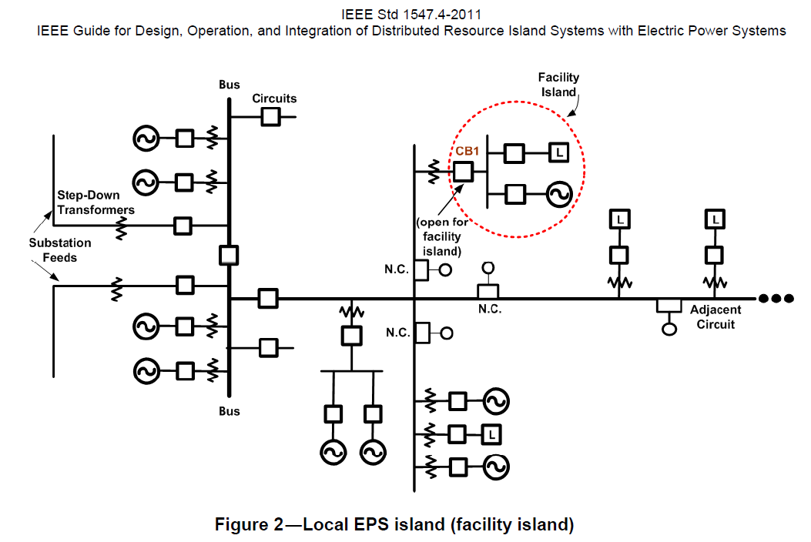
Local electric power system (EPS) island

Slide 20
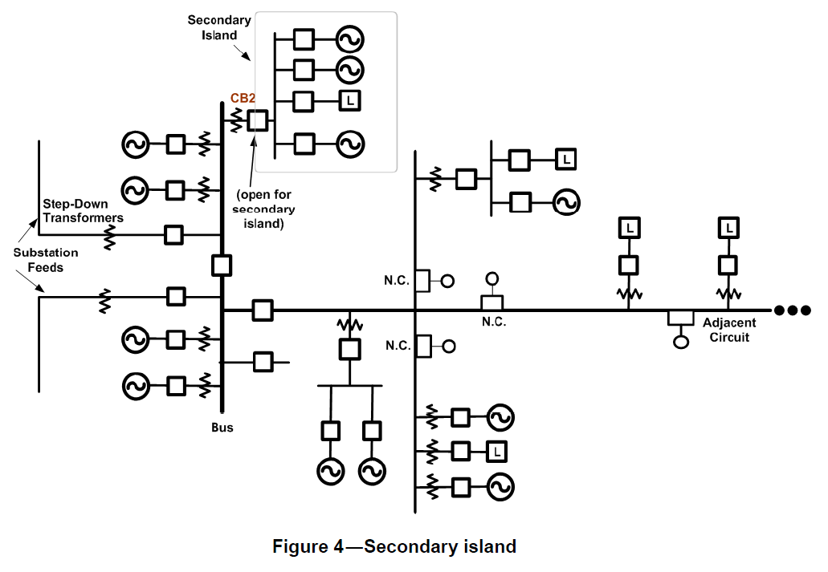
Secondary island

Slide 21
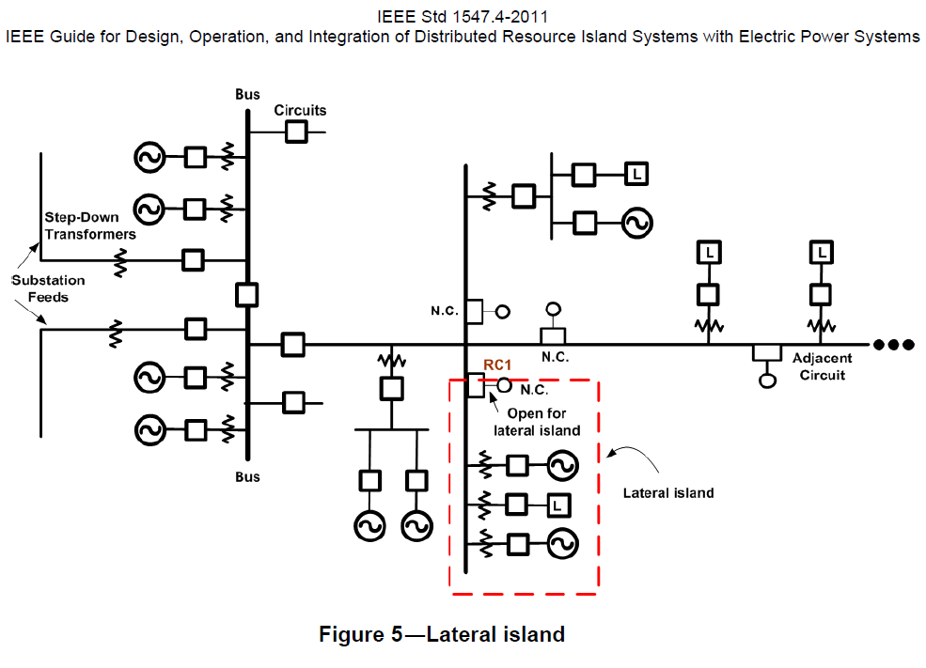
Lateral island

Slide 22
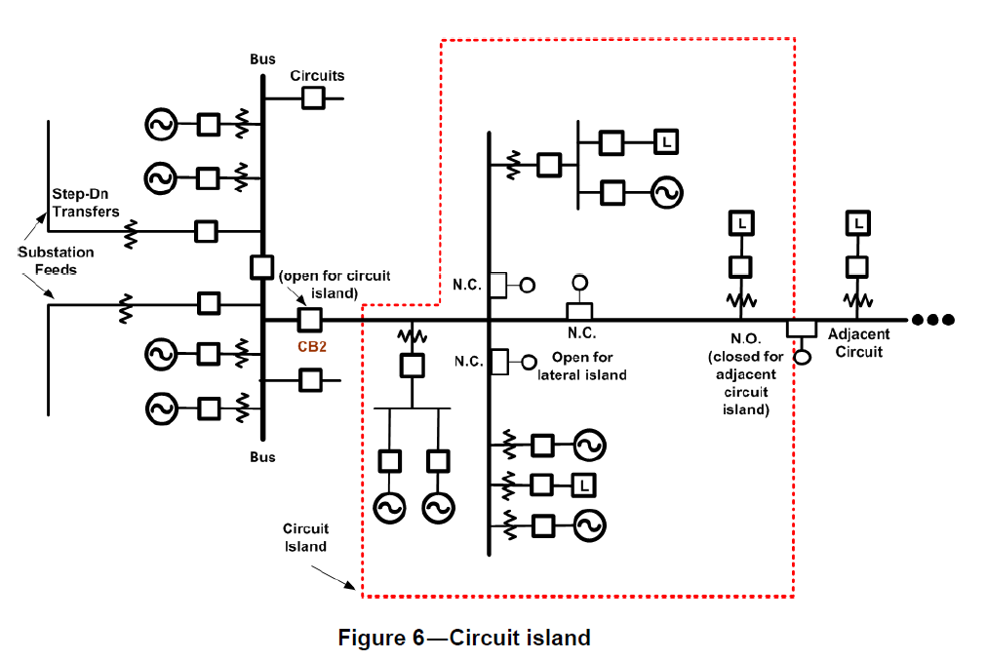
Circuit island

Slide 23
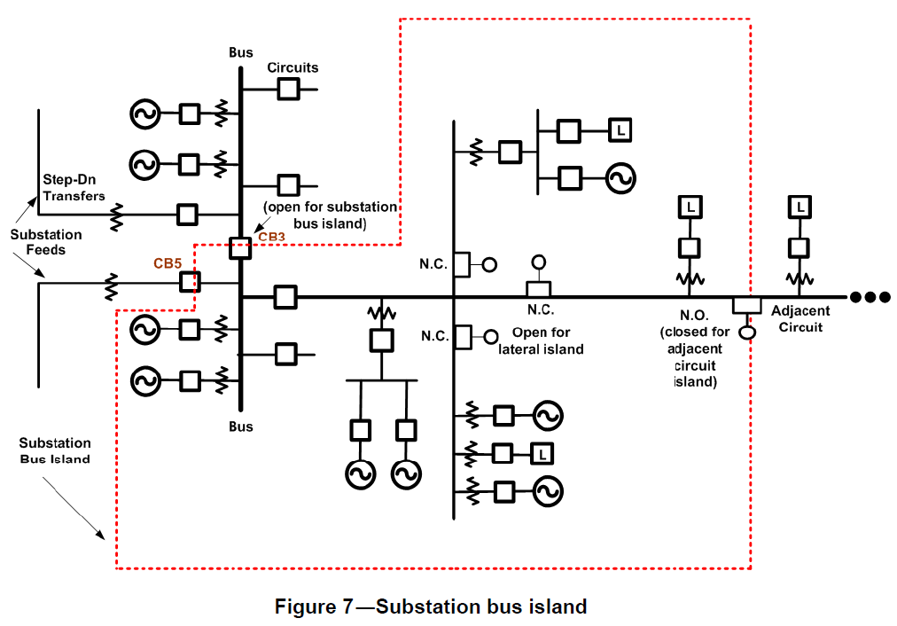
Substation bus island

Slide 24
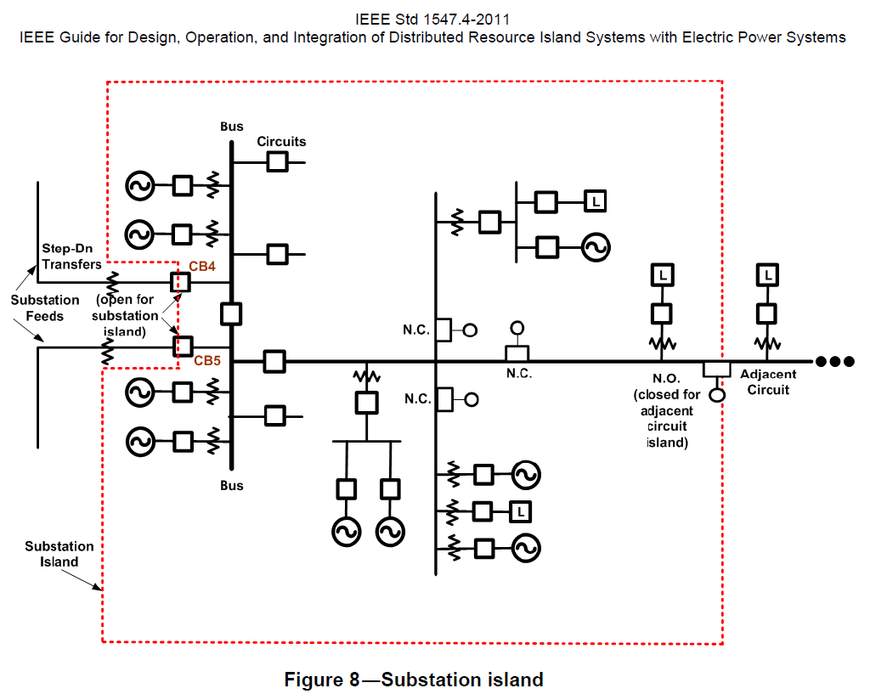
Substation island

Slide 25
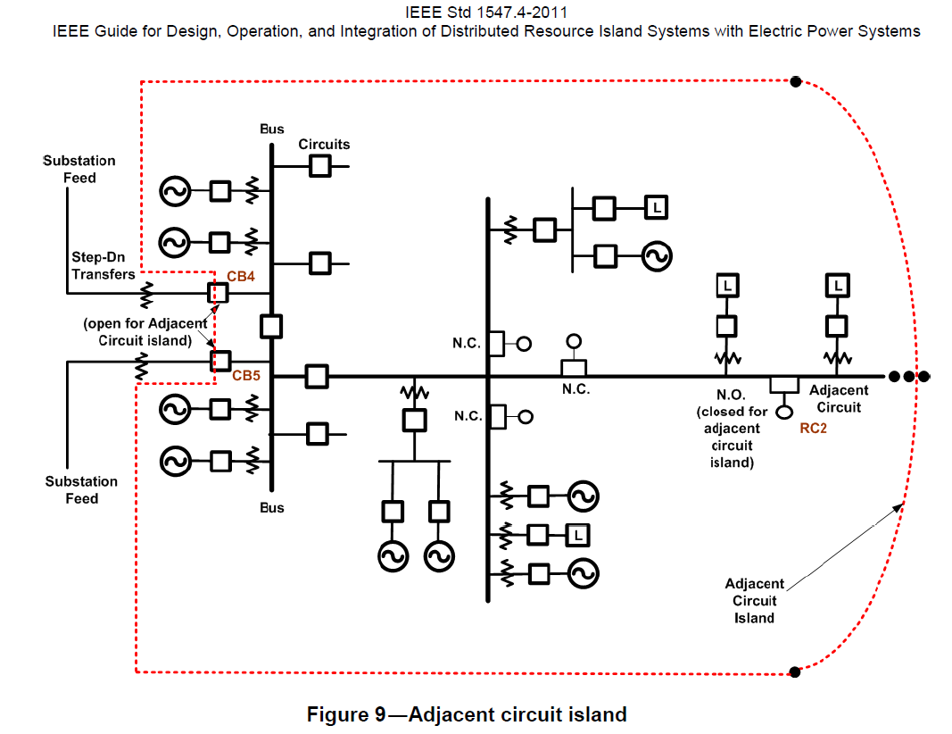
Adjacent circuit island

Slide 26
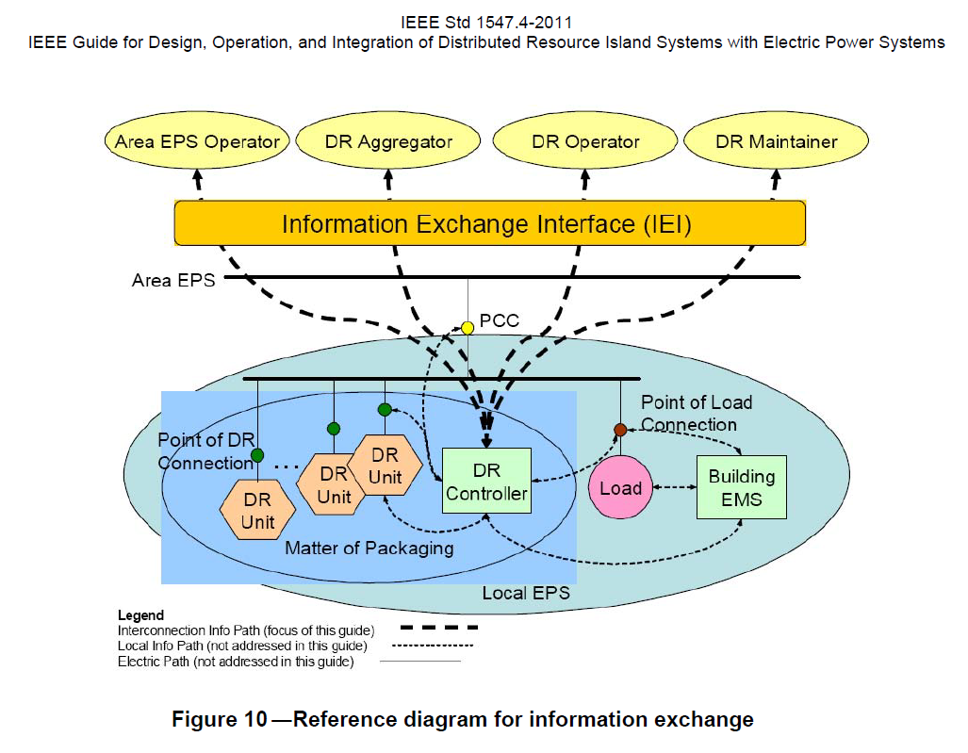
Information exchange

Slide 27
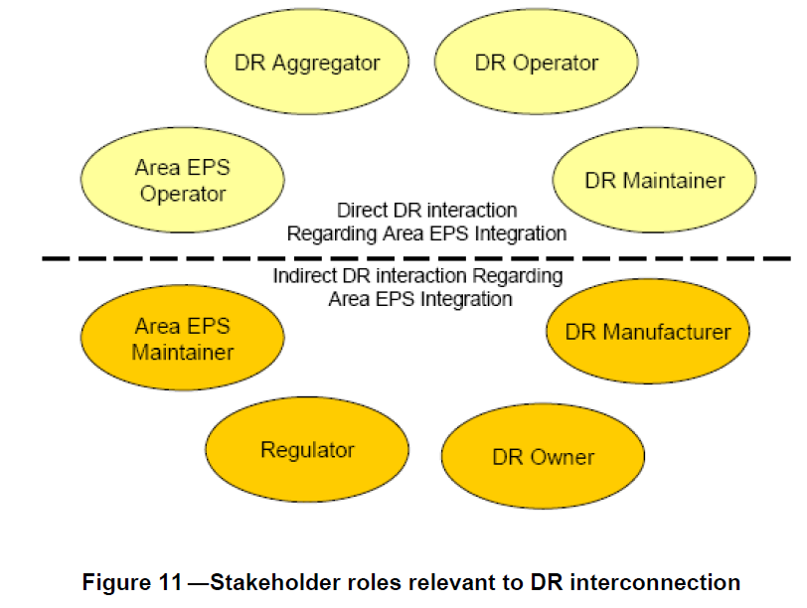
Stakeholders

Slide 28
Existing microgrid implementations
USA:
Dolan technology center (Ohio)
GE global research microgrid: microgrid energy management (demonstration to end in 2008?)
Perfect power at the Illinois Institute of Technology
Military bases: Twentynine Palms Microgrid (GE), Fort Bragg

Slide 29
Existing microgrid implementations (…cont’d 1)
Europe:
Kythnos island (Greece)
Continuon’s MV/LV facility (Netherlands)
MVV Residential demonstration (Germany)

Slide 30
Existing microgrid implementations (…cont’d 2)
Japan (motivated by compensation of local variability and present itself as constant load to the grid):
Aomori (PV, WT, and biogas, biomass, provide electricity and heat, lead acid battery, )
Aichi (fuel cells, biogas, PV, NaS battery, islanding tests)
Kyoto (PV, WT, biogas, fuel cells, battery)
Sendai (demonstrate multiple PQR levels)
Private sector: Shimizu Corporation, Tokyo Gas

Slide 31
Existing microgrid implementations (…cont’d 2)
Canada
Autonomous remote microgrids: Ramea (wind-diesel, 1.2MW peak load, 395kW wind)
Grid connected: Fortis-Alberta (hydro-wind)
Planned microgrid islanding: BC Hydro Boston Bar (3MW peak load, 8.64MW run-of-river hydro), Hydro Quebec (15MW load, 31MW steam)

Slide 32
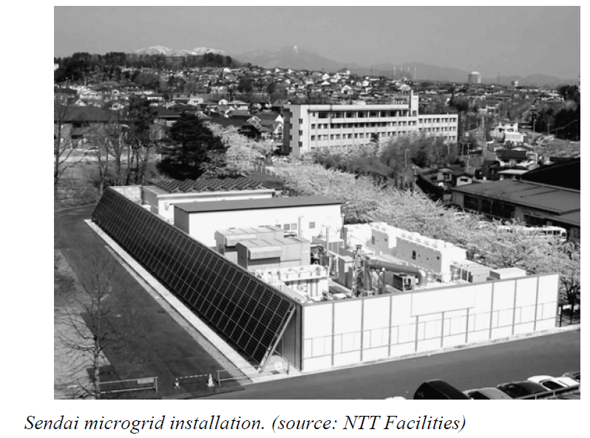
Sendai, Japan Microgrid
DC loads served directly on a circuit dedicated to critical telecommunications equipment
Multiple qualities of AC services:
medical school
high school
water treatment plant

Slide 33
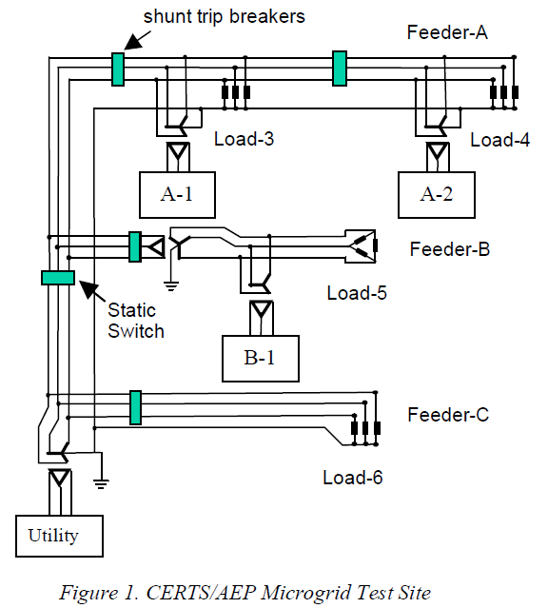
AEP / CERTS microgrid test bed
Tested islanding and resynchronization
Electrical protection system distinguished between normal and faulted operation
Controls robust under motor starts and high impedance faults.
R. H. Lasseter et al, “CERTS Microgrid Laboratory Test Bed,” Submitted to IEEE Transactions on Power Delivery, 2010

Slide 34
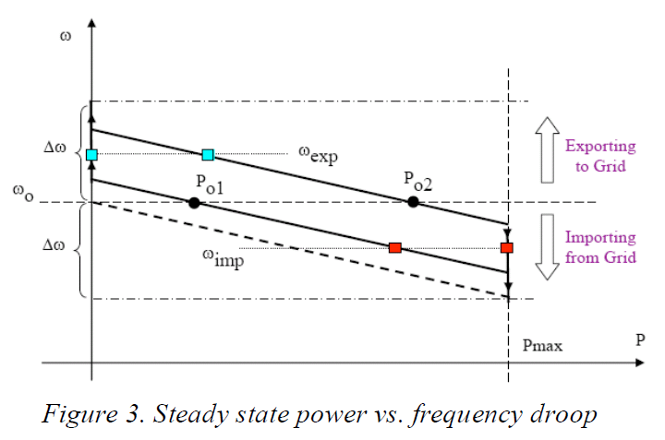
AEP / CERTS microgrid test bed

Slide 35
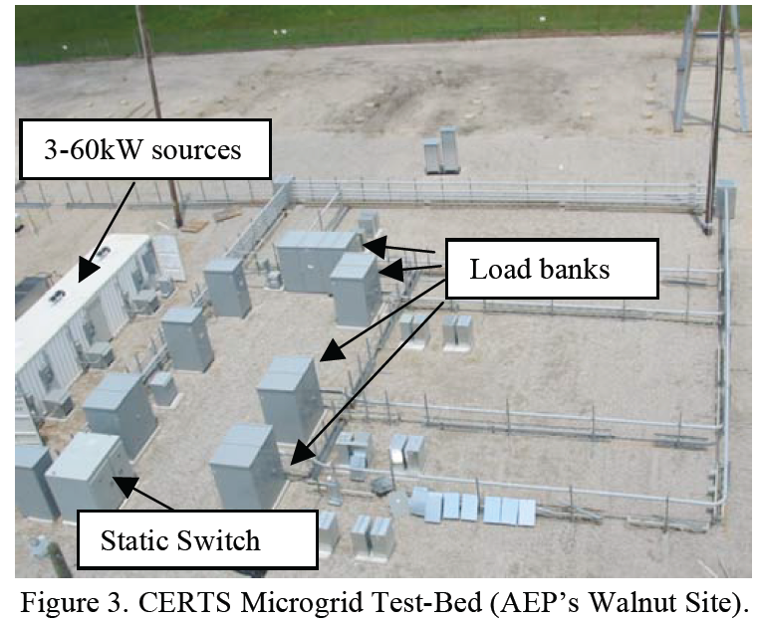
AEP / CERTS microgrid test bed
J. Eto et al, “CERTS Micorgrid Laboratory Test Bed,” California Energy Commission, Public Interest Energy Research Program. CEC-500-2008-XXX

Slide 36
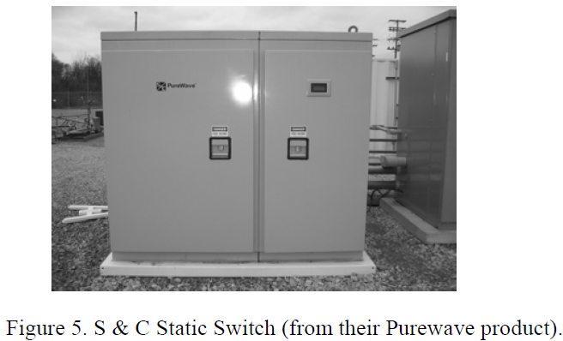
AEP / CERTS microgrid test bed
J. Eto et al, “CERTS Micorgrid Laboratory Test Bed,” California Energy Commission, Public Interest Energy Research Program. CEC-500-2008-XXX

Slide 37
Control of microgrids
Ensure efficient reliable and economic operation and management of microgrids
Control settings and control coordination are different for interconnected mode and islanded mode. Need to adapt
Several levels of control:
Local control at device level (response to local voltage and frequecy)
Microgrid central controller (energy efficiency operation optimization)
Coordination among several microgrids (centralized versus decentralized)

Slide 38
Microgrid stability
When switching to islanding mode stability becomes an issue.
Local voltage and frequency controllers should respond appropriately.
Protection system and settings should be adapted
Stability of isolated microgrid
Stability of frequency is more challenging in isolated microgrid
Need to coordinate voltage control
Droop characteristics good option to solve stability problems

Slide 39
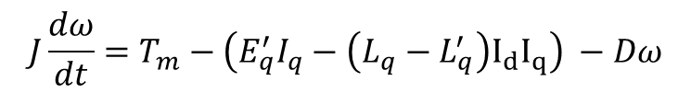
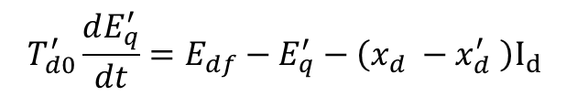
Basic dynamics in isolated microgrid
Generators
$$J\frac{dω}{dt}=T_{m}−\left(E_{q}^{′}I_{q}−\left(L_{q}−L_{q}^{′}\right)I_{d}I_{q}\right) −Dω$$
mechanical
$$T_{d0}^{′}\frac{dE_{q}^{′}}{dt}=E_{df}−E_{q}^{′}−\left(x_{d} −x_{d}^{′} \right)I_{d}$$
Electrical
Anderson, P. M.; Fouad, A. A. Power System Control and Stability (Second Edition). John Wiley & Sons. 2003.
P. Kundur, Power Systems Stability and Control: McGraw-Hill, Inc., 1994

Slide 40

Basic dynamics in isolated microgrid (..cont’d 1)
Motors
$$\begin{matrix}\frac{dω_{g}}{dt}=\frac{1}{\left(J_{g}+J_{turb}\right)}\left[{v^{′}}_{d}I_{d}+{v^{′}}_{q}I_{q}−T_{m}\right] \\ \frac{d{v^{′}}_{q}}{dt}=−\frac{1}{T^{′}}\left[{v^{′}}_{q}−\left(X−X^{′}\right)I_{d}\right]+\left(ω_{g}−1\right){v^{′}}_{d} \\ \frac{d{v^{′}}_{d}}{dt}=−\frac{1}{T^{′}}\left[{v^{′}}_{d}+\left(X−X^{′}\right)I_{q}\right]−\left(ω_{g}−1\right){v^{′}}_{q}\end{matrix}$$
mechanical
Electrical
Anderson, P. M.; Fouad, A. A. Power System Control and Stability (Second Edition). John Wiley & Sons. 2003.
P. Kundur, Power Systems Stability and Control: McGraw-Hill, Inc., 1994

Slide 41
Basic dynamics in isolated microgrid (..cont’d 2)
Network
Links generators motors and other loads
Modeling discussed in module 3 “Distribution level power flow”

Slide 42
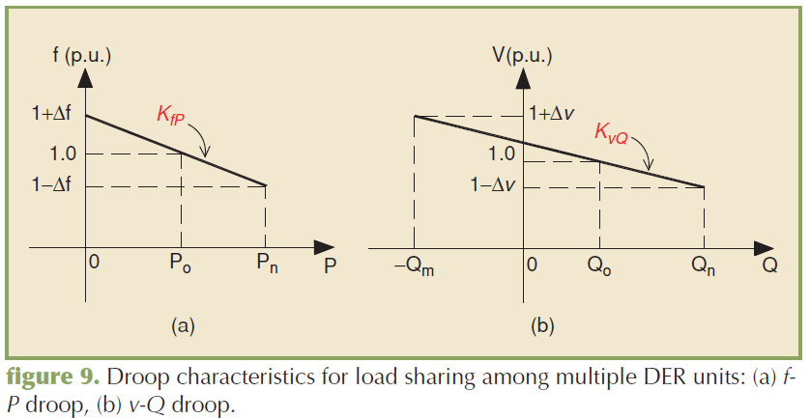
Local control at device level: Two or more DERs
Droop control to share load and reactive power control
F. Katiraei et al, “Microgrids management,” IEEE Power & Energy Magazine, May/June 2008

Slide 43
Power/Energy management objectives
Connected mode:
Specify DER power output for specific objective (e.g. peak shaving, maximize renewables, minimize fuel costs)
Consider limitations of DERs
Main grid to provide difference
Manage settings of DER in preparation to transition to isolated mode
Isolated mode:
Power balance to be met by microgrid resources (no main grid contribution)
Provide power to sensitive loads, use non-sensitive load to help balance the microgrid
Enable reconnection to main grid after restoration

Slide 44
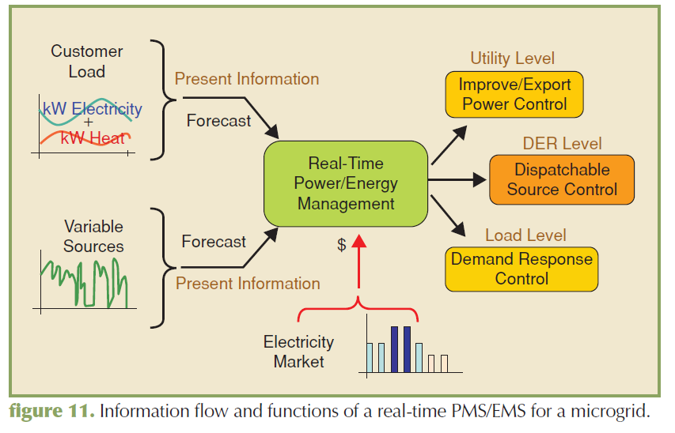
Power/energy management
F. Katiraei et al, “Microgrids management,” IEEE Power & Energy Magazine, May/June 2008

Slide 45
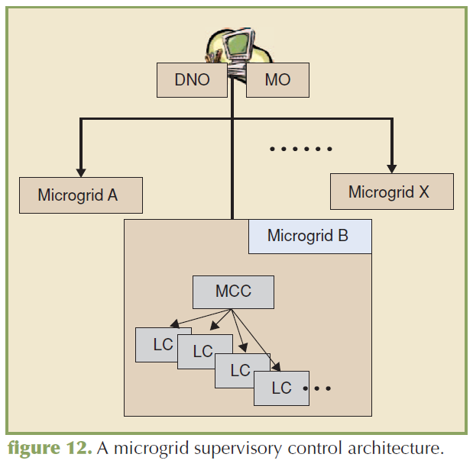
Hierarchical architecture for microgrids
Distribution network operator (DNO)
Market operator (MO)
Microgrid central controller (MCC)
Local controllers associated with individual DER
F. Katiraei et al, “Microgrids management,” IEEE Power & Energy Magazine, May/June 2008

Slide 46
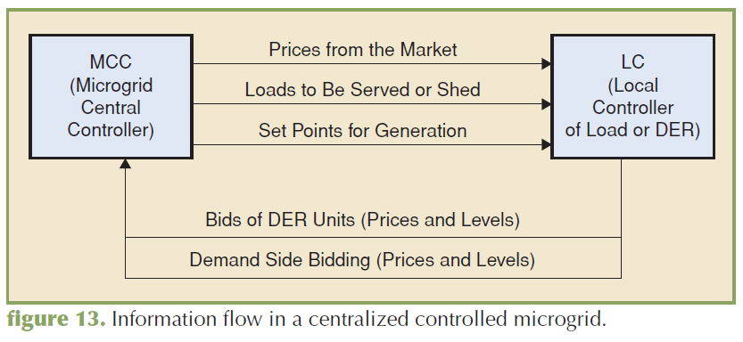
Microgrid central controller
F. Katiraei et al, “Microgrids management,” IEEE Power & Energy Magazine, May/June 2008

Slide 47
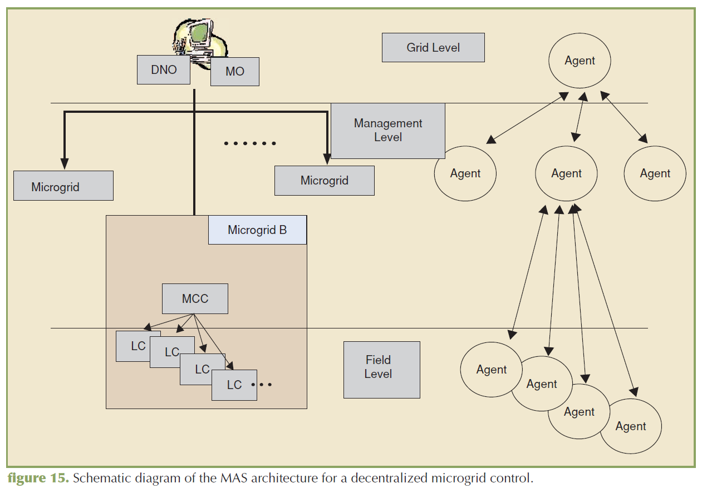
Decentralized coordination of microgrids
F. Katiraei et al, “Microgrids management,” IEEE Power & Energy Magazine, May/June 2008

Slide 48
Protection system for microgrids
Transition between interconnected and islanded mode
Short circuit capacity significantly changes between interconnected and islanded mode. Change in protection settings and logics may be needed.
Fault detection may become an issue because low fault current contribution from power electronic based DERs
Protection coordination should be prepared for bi-directional fault current contributions
Redefinition of anti-islanding protection
In microgrid anti-islanding protection that shuts down DER is not convenient
Islanding detection relays can be used to trigger transition between grid connected and islanded operation method

Slide 49
Extra slides

Slide 50
Other possible topics to cover
Provision of local blackstart?
Determination of benefits?
Policy?
Communication infrastructure and protocols?

Slide 51
CERTS tools
Distribution energy resources customer adoption model (DER-CAM) (Lawrence Berkeley National Lab)
μGrid Analysis Tool (μGrid) (Georgia Institute of Technology)
All necessary electrical analysis needed to design microgrids. (Unbalanced three-phase, and single phase system, voltage and frequency stability, stray voltages, currents and ground potentials)
Didn’t find????????????

Slide 52
Module 10 Concluding Comments
1
2
3
4

